Slide 1
Program Design ITPRA0

Slide 2
Disclaimer
Please note that content made available on myLMS may deviate only slightly from what is covered in lecturer-led sessions, however, the content uploaded to myLMS represents all the material that you need to refer to in preparation for your assessments.

Slide 3
Eduvos and the Flipped Classroom
1
2
3
Before this lecturer-led session
During this lecturer-led session
After this lecturer-led session
At home, in your self-study time, you worked through myLMS content to prepare you for this lecturer-led session. You have completed any practice activities and prepared any questions you may still have on the content. The lecturer-led session will not be a traditional lecture.
During your lecturer-led session(s), you will engage with your peers and lecturer in active learning. I.e. you will have an opportunity to ask your questions, to debate topics, and to practice working through the technical aspects of what you learnt at home. You will be exposed to higher-order thinking activities. Your lecturer will guide you on what to prepare before attending your next session.
Depending on how difficult this lecturer-led session is, your lecturer may recommend some concepts to revise for this week's learning opportunities. Then you will focus on the following learning opportunities on myLMS in your self-study time to prepare for the next lecturer-led session(s).
3

Slide 4
What will be covered in the rest of today’s session?
Introduction to decision making in programming
Understanding Boolean expressions (True/False logic)
Writing IF and IF–ELSE statements in pseudocode and Python
Using relational operators for comparisons
Understanding the equality operator (==) vs assignment (=)
Avoiding common mistakes with conditions and boundaries
Implementing nested IF statements
Performing range checks using IF and elif
Using logical operators (AND, OR, NOT)
Understanding truth tables for logical operators
Applying short-circuit evaluation in conditions
Writing real-world programs (grading, access control, working age)Introduction to exception handling (try-except)
Exception Handling

Slide 5
Introduction to decision making
Computers appear intelligent because they can make decisions
Example:
Learning platforms recommend personalised study materials
In programming, decisions are made using: Selection Structures
A selection structure allows a program to choose between two possible actions depending on the outcome of a condition test

Slide 6
Boolean expression
A Boolean expression evaluates to: True or False
x = 10
x > 5 # True
x < 3 # False
All decisions are based on true or false

Slide 7
Selection Structures
if condition then
statements
else
statements
endif
Used to choose between actions
Structure:
If condition is True → do one thing
Else → do another

Slide 8
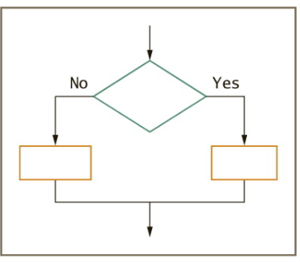
Python structure
if condition:
# statements
else:
# statements

Slide 9
Example Selection Structure
if mark is greater than or equal to 50 then display "Pass" else display "Fail" endif
mark = 65 if mark >= 50: print("Pass") else: print("Fail")

Slide 10
Relational Operators
Used to compare values:
== Equal!
= Not equal
>Greater than
< Less than
>= Greater or equal
<= Less or equal

Slide 11
Relational operators: Example 1
if customerAge is greater than or equal to 65 then
display "Apply 10% discount"
else
display "Charge full price"
endif
customer_age = 70
if customer_age >= 65:
print("Apply 10% discount")
else:
print("Charge full price")

Slide 12
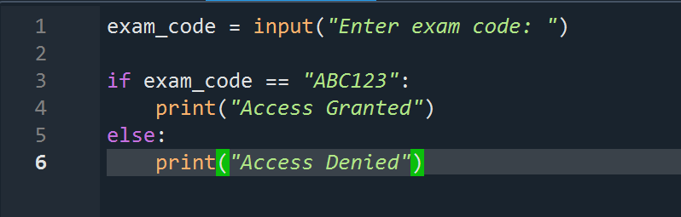
Relational Operators: Example 2
display "Enter exam code"
input examCode
if examCode is equal to "ABC123" then
display "Access Granted"
else
display "Access Denied"
endif

Slide 13
Nested IF
A nested selection structure occurs when one decision (IF/ELSE) is placed inside another. It allows programs to handle multiple levels of conditions.
For example, suppose we need to determine whether a person falls within the working age range. A person is considered to be of working age if:
They are 18 years or older, and
They are younger than 60

Slide 14
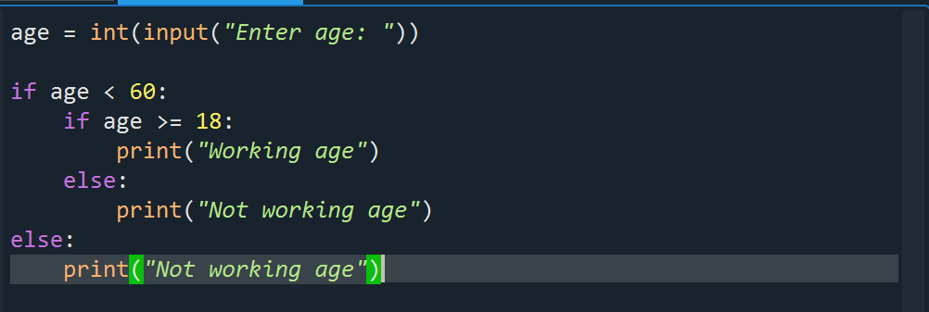
Example Nested IF
if age is less than 60 then
if age is greater than or equal to 18 then
display "Working age"
else
display "Not working age"
endif
else
display "Not working age"
endif

Slide 15
Nested IF: Grading Example
if mark >= 70:
print('Distinction')
elif mark >= 60:
print('Merit')
elif mark >= 50:
print('Pass')
else:
print('Fail')
Notes:
Explain range checking and elif usage.

Slide 16
Logical operators
Used to combine conditions. These include
AND
OR
NOT

Slide 17
AND Operator
Both conditions must be True

Slide 18
OR Operator
At least one condition must be True

Slide 19
NOT Operator
Reverses a condition

Slide 20
The Guess and Check Pattern
A problem-solving pattern used in programming
Involves:
Making a guess
Check if the guess is correct
If not, update the guess
Repeat until correct
Why use it?
Simplifies complex logic
Makes code easier to read and understand

Slide 21
The Guess and Check Pattern
Compared to complex code:
Avoids nested if statements
Uses simple, clear steps
Reduces unnecessary else statements
Key Idea: Break problems into:
Guess → Check → Update
Benefit:
Cleaner code
Easier to debug and maintain

Slide 22
The Guess and Check Pattern: Example
Example
Explanation
x = int(input("Please enter an integer:"))
y = int(input("Please enter another integer:"))
z = int(input("Please enter a third integer:"))
maxNum = x # initial guess
if y > maxNum:
maxNum = y # update guess
if z > maxNum:
maxNum = z # update guess again
print(maxNum, "is greatest.")
How it works:
Start with a guess → assume x is the largest
Check if y is bigger → update if needed
Check if z is bigger → update again
Final value is the correct maximum
Why this is good:
No nested if statements
No unnecessary else
Simple, clear, and easy to follow

Slide 23
Short Circuit Logic
Cases where the program does not need to evaluate all parts of a condition to determine the final result.

Slide 24
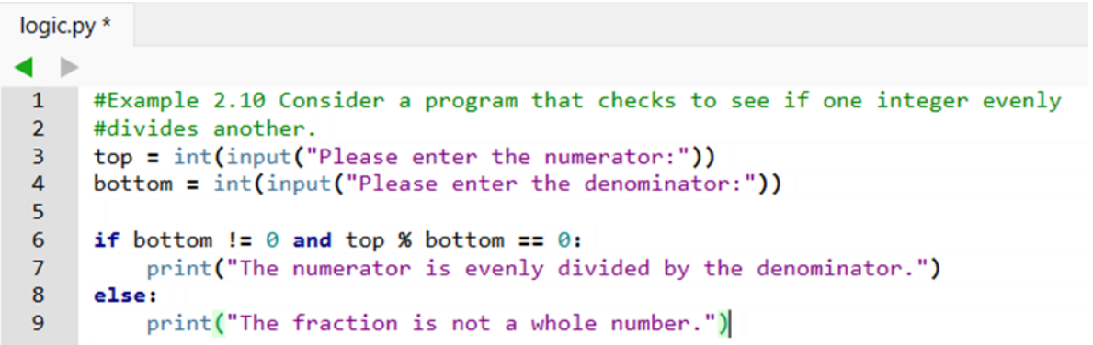
Example: Short circuit evaluation
Division by 0 will never happen in this code because Python, and most programming languages, uses short-circuit logic.

Slide 25
Comparing Floats
Floats are stored using 8 bytes (64 bits)
Floats are approximations, not exact values
This leads to round-off errors
Errors are usually very small and acceptable
Comparing floats using == can be unreliable
Two values that should be equal may differ slightly

Slide 26
Comparing floats: Example
Floats are approximations, not exact values
Direct comparison can give unexpected results
Example (Incorrect):
x = 0.1 + 0.2 y = 0.3 print(x == y) # False
Even though mathematically they are equal, Python returns False
Correct Example:
Compare using a small tolerance (epsilon)
x = 0.1 + 0.2 y = 0.3 print(abs(x - y) < 0.0001) # True
Key Point: Always compare floats using a tolerance, not ==

Slide 27
Exception Handling
Sometimes programs encounter errors at runtime
These errors may be outside the programmer’s control
Example: invalid user input
Exception handling:
A way to handle errors gracefully
Prevents the program from crashing
Allows the program to continue running

Slide 28
Basic structure Exception Handling
try:
# code that may cause an error
except:
# code that handles the error
try:
number = int(input("Enter a number: "))
print("You entered:", number)
except:
print("Invalid input! Please enter a valid number.")

Slide 29
Activity 1
A program is used to determine whether a person is allowed to enter an event.
A person is allowed entry if:
They are 18 years or older
Write pseudocode to determine if a person is allowed entry.
Write a Python program that implements this logic.
What output will be produced for the following ages:
i) 20 ii) 17

Slide 30
Activity 2
A program asks a user to enter a number and then displays the result.
number = int(input("Enter a number: ")) print("You entered:", number)
What error will occur if the user enters "abc" instead of a number?
Rewrite the program using a try-except statement to handle this error and display an appropriate message.
Explain how the try-except statement improves the program. (2 marks)

Slide 31
Summary
IF controls flow
Relational Operators compare values
Logical operators combine conditions
Try …except handles errors

